Slide 1
Microsoft Cognitive Services
Amplifying human ingenuity
Jonathan Scholtes
Data and AI Solutions Professional
December 5th, 2018
Notes:
And then we have three different communities that we support. We have our MSDN forums, our Stack Overflow, and we have User Voice that we use for feedback requests.

Slide 2
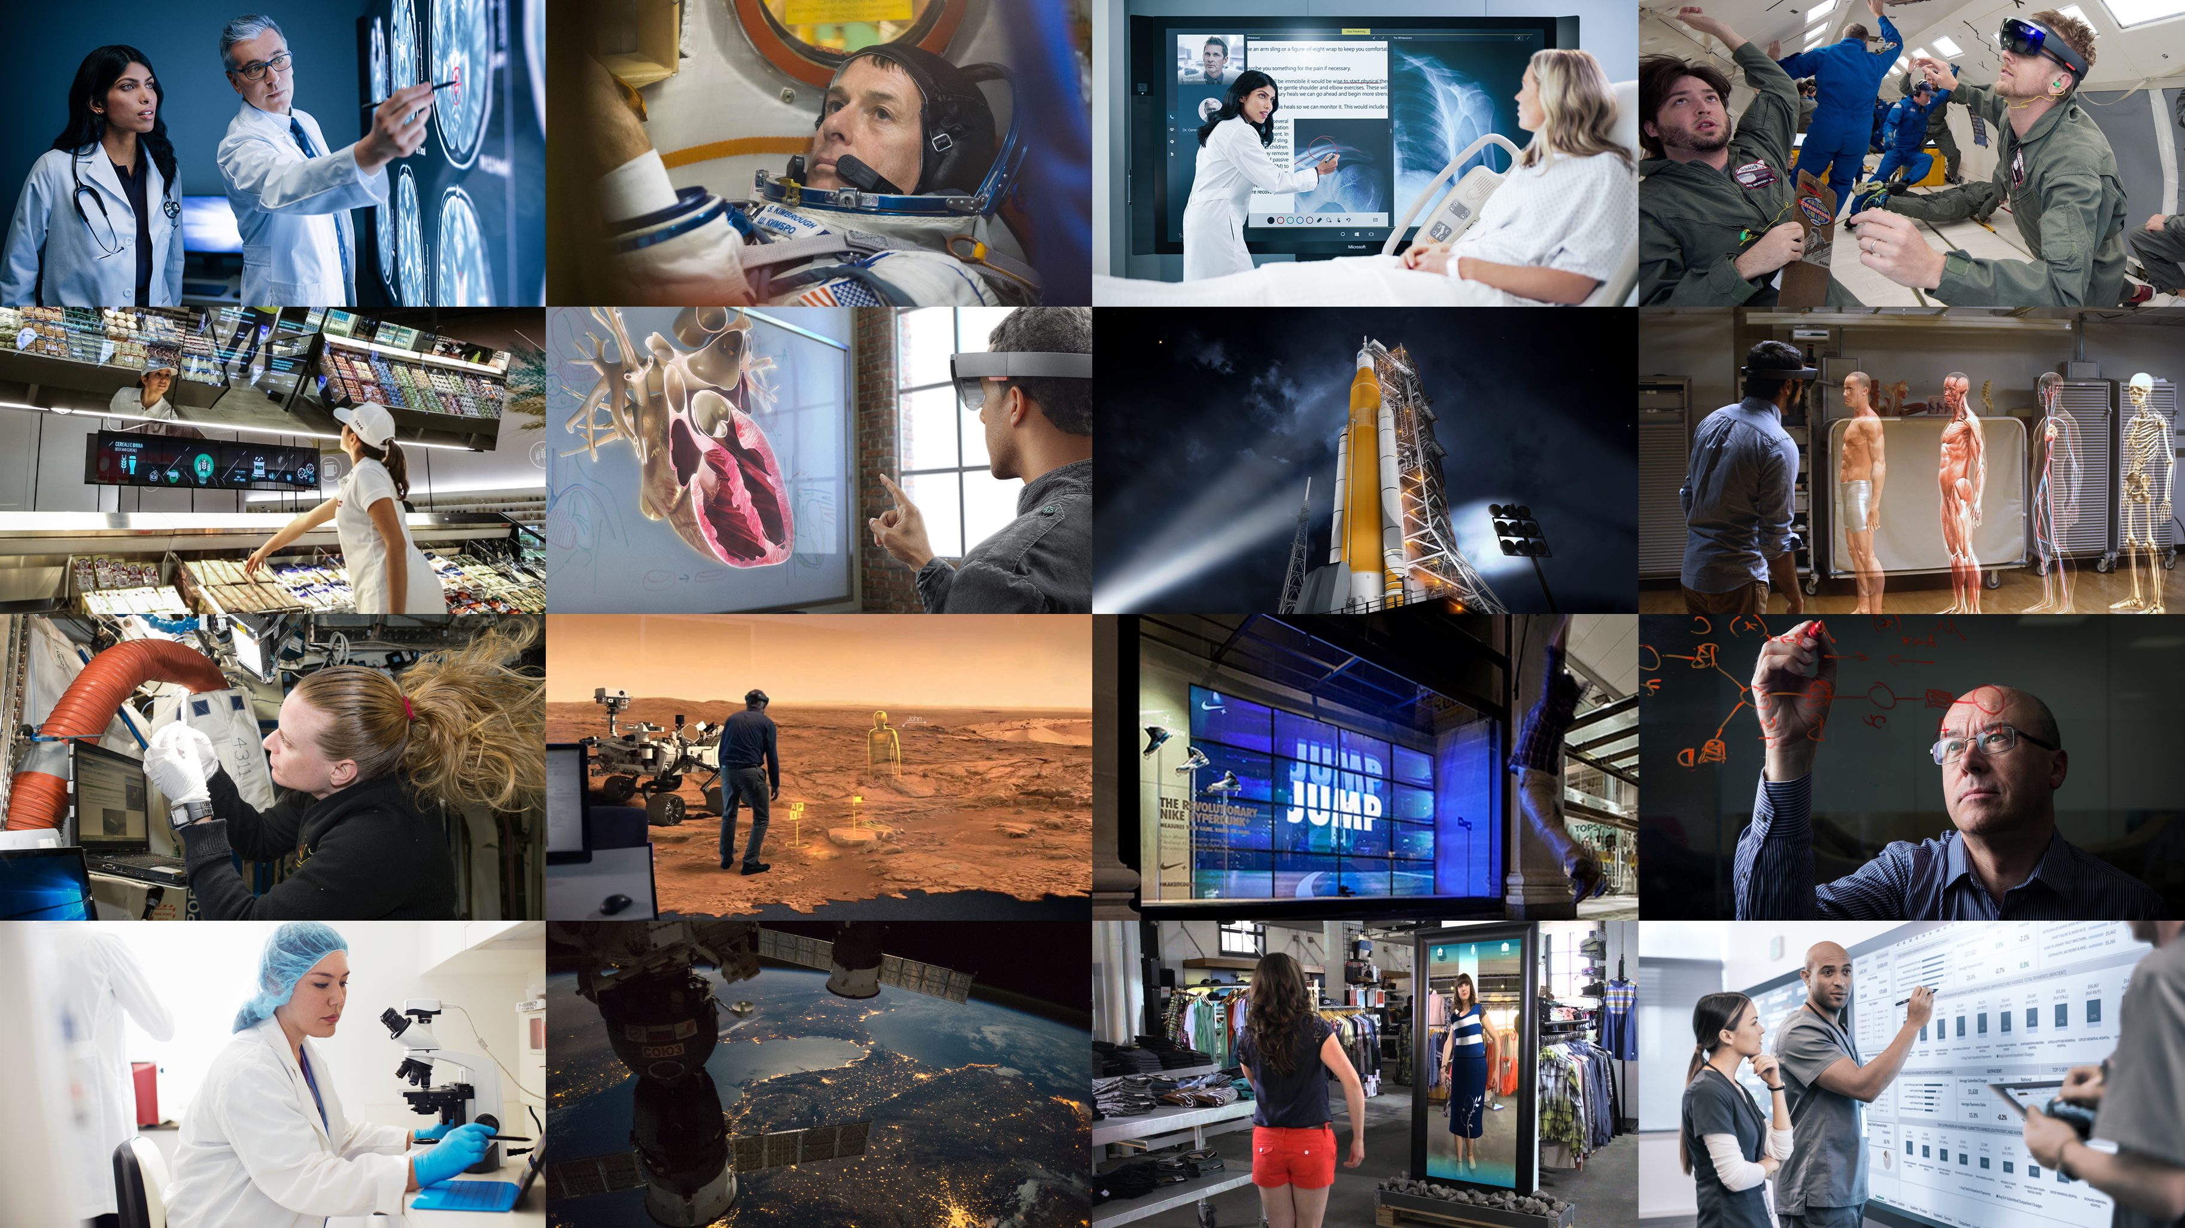
You have more power at your fingertips than ever before.
Notes:
Today huge volumes of data are available for our apps and services – data is coming from many new and exciting sources and we are being asked to deliver it to our customers in new and exciting ways. We are being asked to deliver customer experiences that in a natural and seamless manner must accommodate a new variety of inputs: images, videos, speech and free form text. Customers are wanting an experience that works with them and for them – driven by intelligence, driven by AI.
Luckily you have access to more computing power and functionality in the cloud than ever before. Data store options to fit your volume, variety and velocity requiremtne. Compute that can scale with your needs, simplicity in application deployment and scaling, and infusion of AI.

Slide 3
Azure Data + AI
Data
AI
Data Modernization on-premises
AI apps & agents
Data modernization to Azure
Knowledge mining
Globally distributed data
Machine learning
Cloud Scale Analytics
Notes:
Data and AI are interdependent topics, the best solutions are really built when an organization has a sound data strategy that enables it to leverage AI. [Customer Conversations].
What Microsoft has done is organized clear focus areas to help you succeed with both data and AI.
Today we will be focusing in on leveraging intelligent apps and agents with AI

Slide 4
Customized language understanding
Text-to-speech
Content moderation
Spell check
Speech translation
Custom image classification
AI
Speaker recognition
Entity linking & augmentation
Vision
Speech
Language
Sentiment analysis, key phrase extraction
Image tagging
Custom voice
Object detection
Text translation
Intend analysis
OCR handwriting recognition
Emotion detection
Video insights
Custom translation
Face identification
Assisted text moderation
Custom speech
Speech transcription
Notes:
AI represents the ability to take a lot of data that you have and to teach machines to make intelligent predictions on it.
These are some of the most common use cases:
Computer Vision is enabling organizations to use images and video to change the way they handle a variety of scenarios to enable things like facial recognition and object detections
Speech is enabling organization to transcribe speech to text or enable natural sounding text to speech in a seamless and easy manner
Speech sdk 3.0 2006/2008
Supplement, not replace -
Finally, language is the ability to not only transcribe but to also understand what the intent of the user is and how to create a flow of dialog.

Slide 5
Azure AI
AI apps & agents
Knowledge mining
Machine learning
Azure Bot Service
Azure Cognitive Services
Azure Cognitive Search
Azure Databricks
Azure Machine Learning
Azure AI infrastructure
Notes:
There are three main solution you can build with Azure AI
First you can build AI apps and agents that have the ability to interact with the user naturally with pretrained AI models and bots.
Second, you can unlock insights lying latent in your content with knowledge mining.
And lastly, you can build your own AI machine learning models. – even thought some of you in this room may not develop ML models - integrate into your apps and services by deploying as APIs
Today we are going to dive specifically into AI apps and agents (Azure Cognitive Services)

Slide 6






Adding intelligence
Azure Cognitive Services
Intelligent Agents
Cognitive Services
Machine Learning
Core infrastructure
Vision
Speech
Language
Knowledge
Search
Notes:
Infuse your apps with human like intelligence with Azure Cognitive Services.
So, what are Cognitive Services? Cognitive Services are a collection of artificial intelligence APIs, and we believe in democratizing artificial intelligence. So what that means is, regardless of your skill level – (whether you're a high school student running your first program or working in industry or in a giant enterprise) -- that you should be able to use these APIs quickly - in a matter of minutes.
SDK
Regardless of your platform -- whether you're on Android or IOS or Windows, or making a website -- all of our APIs are rest APIs, which means you can call them as long as you have an Internet connection. ** There is a subset of APIs that can run in containers and on the IOT Edge. And so that's pretty huge because what we're doing is making it so that everyone can build these smarter, more context-aware applications.

Slide 7


Vision
From faces to feelings, allow your apps to understand images and video
Computer Vision | Video Indexer | Custom Vision |
Face | Content Moderator
Notes:
With Vision you get image processing algorithms to identify caption, and moderate your pictures and video.

Slide 8

Speech
Hear and speak to your users by filtering noise, identifying speakers, and understanding intent
Unified Speech service |
Speech to Text | Text to Speech | Speech Translation
Speaker Recognition
Notes:
With speech you can convert spoken audio in a text, use voice for verification, or add speaker recognition to you app.
[baseline vs custom speech]

Slide 9
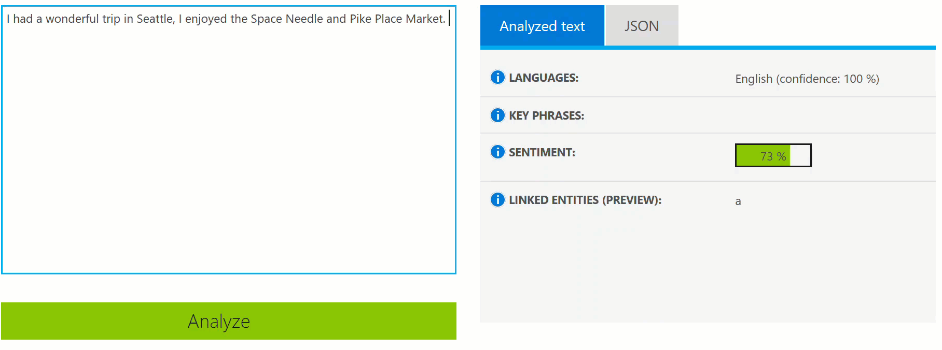
Language
Process text and learn how to recognize what users want
Text Analytics | Bing Spell Check | Language Understanding | Translator Text
Notes:
With language you can enable your apps to process natural language with prebuilt scripts, evaluate sentiment and learn how to recognize what your users want.
With the text analytics API, for example, it’s a cloud based service that provides advanced natural language processing over raw text and includes four main functions: sentiment analysis, key phrase extraction, language detection, and entity linking.

Slide 10
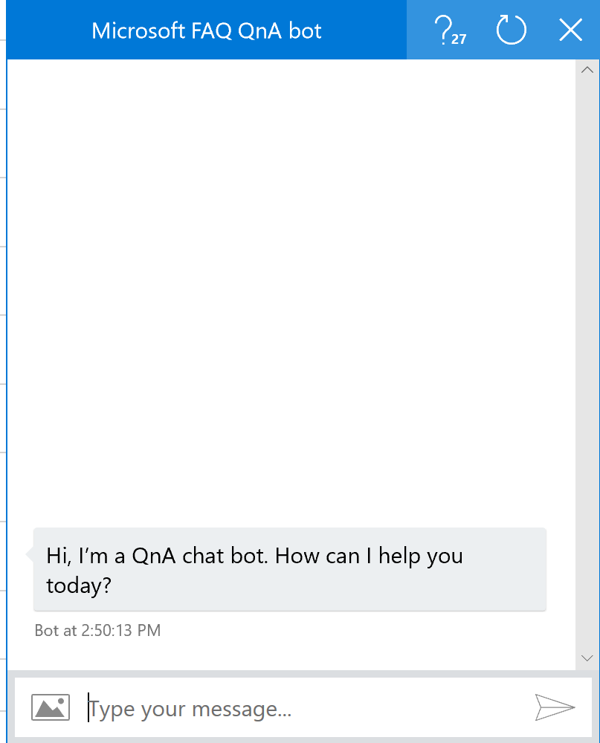
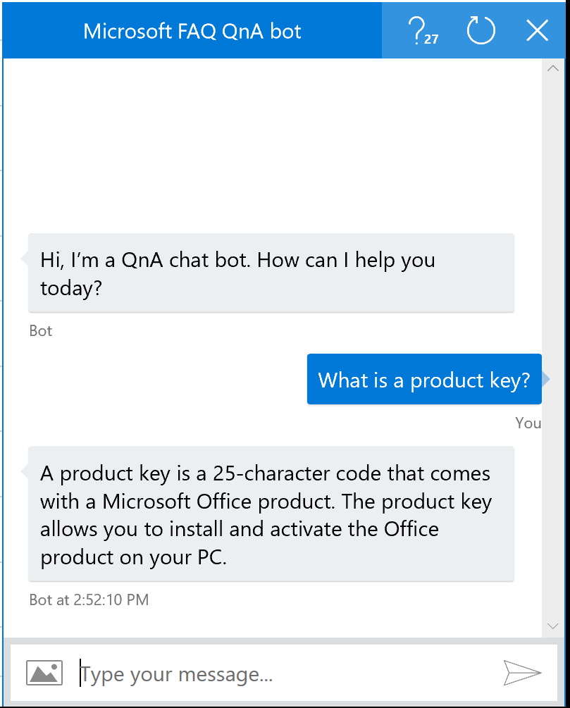
Knowledge
Map complex information and data in order to solve specific tasks such as QnA pairs extraction
QnA Maker | Custom Decision
Notes:
With knowledge, you can map complex information and data in order to solve tasks such as intelligent recommendations and semantics search.

Slide 11


Search
Access billions of web pages, images, videos, and news with the power of Bing APIs
Bing Web Search | Bing Custom Search | Bing Video Search |
Bing Image Search | Bing Visual Search | Bing Entity Search |
Bing News Search | Bing Autosuggest | Bing Statistics add-in
Notes:
And with search, you can add Bing Search APIs to you apps and harness the ability to comb billions of web pages, images, videos, and news with a single API call.

Slide 12

Let Cognitive Services Be Your Application’s Super Power
Intelligent
Business Ready
Easy to Deploy
Customizable
Combinable
Notes:
With these easy to integrate rest APIs Cognitive Services will be you applications super power..
Interactive conversations are the future of applications
Everyone wants to interact with applications in a more human way .
These APIs can be combined, like building blocks, to infuse your business with AI, and rapidly accelerate time to market.
Easy to deploy to desktop, mobile, web

Slide 13








Why Microsoft Cognitive Services?
Easy
Flexible
Tested
www.microsoft.com/cognitive
Roll your own with REST APIs
Simple to add: just a few lines of code required
Integrate into the language and platform of your choice
Breadth of offerings helps you find the right framework for your app
Bring your own data for your custom experience
Built by experts in their field from Microsoft Research, Bing, and Azure Machine Learning
Quality documentation, sample code, and community support
Get a key,
Build
Notes:
Why choose these APIs ? They work, and it’s easy.
Easy: The APIs are easy to implement because of the simple REST calls. Being REST APIs, there’s a common way to implement and you can get started with all of them for free simply by going to one place, one website, www.microsoft.com/cognitive. (You don’t have to hunt around to different places.)
Flexible: We’ve got a breadth of intelligence and knowledge APIs so developers will be able to find what feature they need; and importantly, they all work on whatever language, framework, or platform developers choose. So, devs can integrated into their apps—iOS, Android, Windows—using their own tools they know and love (such as python or node.js, etc.).
Tested: Tap into an ever-growing collection of powerful AI algorithms developed by experts. Developers can trust the quality and expertise build into each by experts in their field from Microsoft’s Research organization, Bing, and Azure machine learning and these capabilities are used across many Microsoft first party products such as Cortana, Bing and Skype.
AI has been part of the Microsoft story for the last 2 decades, early as 1997 we used ML to categorize regular main versus junk mail.

Slide 14
Building AI apps & agents
Vision
Speech
Language
Your Apps
Notes:
So what is an AI app and agent and how do you build one?
The simplest way to get started is to take your existing web and mobile application and add vision, speech, or language capabilities to them using AI models we have build.
##There are a number of customers adding AI capabilities to their apps and driving significant business impact today.

Slide 15
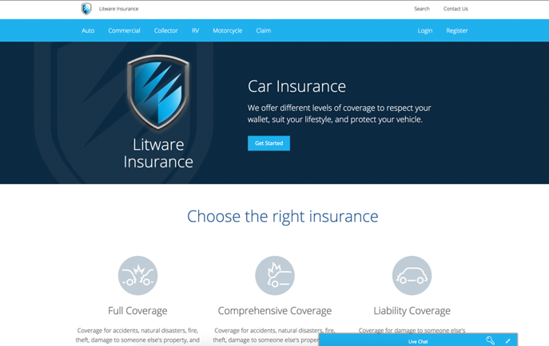
Intelligent Apps & Agents Demo
Litware

Slide 16


AI apps & agents: How the demo was built
Data
AI
Apps
Azure Cosmos DB
…
Azure App Service
Web & mobile apps
Vision
Speech
Language
Search
Cognitive Services
Bot Service
Azure SQL DB
CRM
Notes:
AI does not live in isolation, you need core data and app services to make this happen. Use services with Azure to store data, utilize AI, and to deploy applications.
All apps need databases. With Azure, you have two industry leading databases for both SQL and NoSQL to handle any variety of data. (Azure SQL DB and Azure Cosmos DB)
Azure Bot Service provides you an integrated environment that helps you build, connect, deploy and manage an intelligent agent to interact naturally with their users.
Give your bot the ability to see, hear, and interpret your users by seamlessly integrating Cognitive Services
In this particular scenario, the bot is surfaced as a web service, so Web Apps was used to deploy the application.

Slide 17
Cloud-Native App Challenges
Multitude of data types
Customer demands for low latency experience
Cross-region mission critical durability
Real-time personalization
Notes:
To develop intelligent, cloud-native apps, you need:
Ability to support multiple types of data, so that you can focus on developing great applications without having to worry about defining data schemas
Global distribution and low latency to meet your customers’ demanding requirements
Cross-region durability so that your applications experience zero downtime
Ability to provide customers with personalized experiences wherever they are

Slide 18






Azure Cosmos DB
A globally distributed, massively scalable, multi-model database service
Table API
Column-family
Document
Key-value
Graph
Elastic scale out
of storage & throughput
Guaranteed low latency at the 99th percentile
Five well-defined consistency models
Turnkey global distribution
Comprehensive SLAs
Notes:
For cloud-native apps, we have Azure Cosmos DB.
Cosmos is a schema agnostic database engine that supports multiple data models including key-value, document, wide-column, and graph data models. It will seamlessly grow as your application grows – even for millions of requests per second over hundreds of terabytes.
Cosmos DB does for NoSQL what SQL does for relational data, it delivers outstanding performance. It guarantees that you have latency of under 10 milliseconds, guaranteed.
And it also offers turnkey global distribution to any number of regions. Cheat the speed of light by bringing data close to your users, enabling CDN-like capabilities over an indexed dynamic database.
[NEED TALKING POINT ABOUT PERSONALIZED EXPERIENCES]

Slide 19
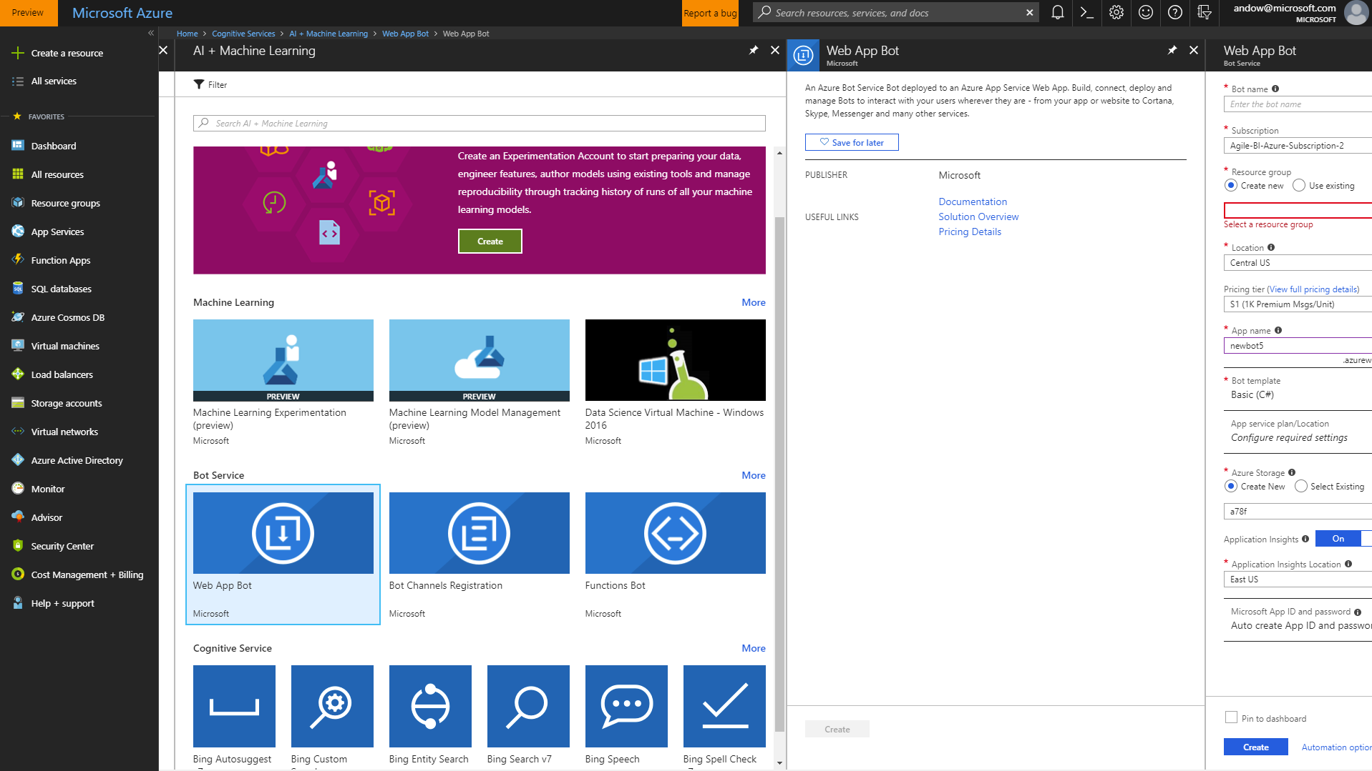
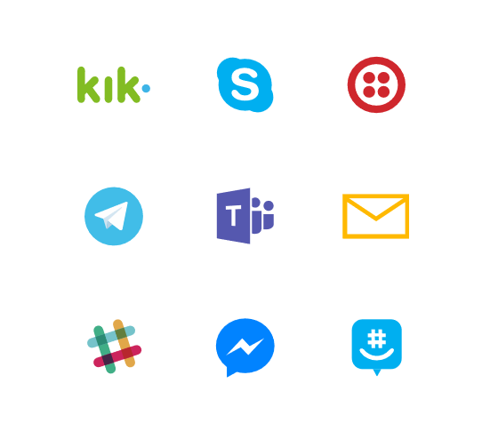

Azure Bot Service
Integrated environment, purpose-built for bot development
Out-of-the-box templates to get started in seconds
Built on Bot Framework SDK with support for .NET and Node.js
Connected across multiple channels
Notes:
Azure Bot Service helps you build a great conversation bot. It speeds up development by providing an integrated environment that’s purposed built for bot development with Microsoft Bot Framework connectors and Bot Builder SDKs. Developers can get started in seconds with out of the box templates for scenarios including language understanding, question and answer, and proactive bots.
Users interact (talk) in many places, the bots you build should too. Azure Bot Service can be integrated across multiple channels to increase interactions and reach more customers using you website or app to email, group me, Facebook Messenger, Kick, Skype, Slack, Microsoft Teams, Telegram, text, Twilio, Cortana, and Skype for Business.
All hosted in Azure and live

Slide 20
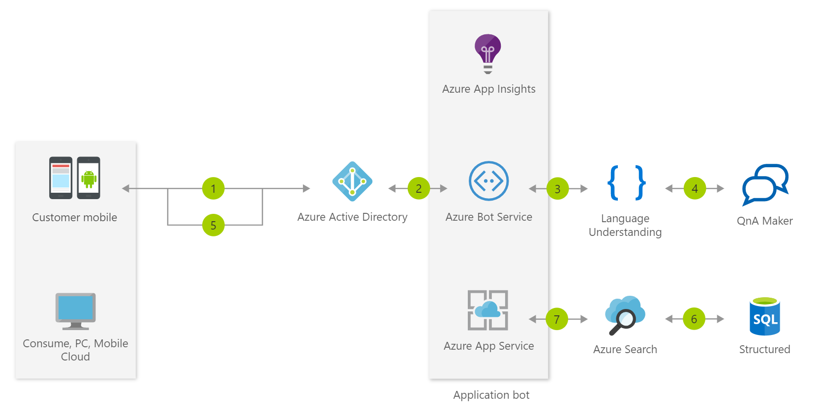
Bot Use Cases
Commerce Chatbot
Create conversational interfaces for various scenarios like banking, travel, and entertainment.
Information Chatbot
Answer questions in a knowledge set or FAQ using QnA Maker and answer more open-ended questions using Azure Search.
Enterprise Productivity Chatbot
Streamline common work activities by integrating external systems.
Notes:
You can used Azure Bot Service to enable a number of scenarios, such as building a commerce chatbot, an information chatbot or an enterprise productivity chatbot.

Slide 21
Developer resources
Pricing
https://azure.microsoft.com/en-us/pricing/details/cognitive-services/
Documentation
https://docs.microsoft.com/en-us/azure/#pivot=products&panel=cognitive
Client SDKs
https://azure.microsoft.com/en-us/resources/samples/?sort=0&term=cognitive+services https://github.com/southwood/project-oxford-python
Example Code
https://github.com/jsturtevant/happy-image-tester-django
https://github.com/Microsoft/Cognitive-Face-Android https://github.com/Microsoft/Cognitive-Samples-IntelligentKiosk
Join Our Community
https://stackoverflow.com/questions/tagged/microsoft-cognitive
https://cognitive.uservoice.com/
Notes:
Access to strong documentation, sample code and community resources is critical for developers to be able to understand and become users of Cognitive Services. Customize these links based on your own resources or use the ones listed here.

Slide 22
DEMO

Slide 23
Q&A

